Slide 1
When God Calls
Jeremiah 1

Slide 2
Why Would Jeremiah Hesitate?
The task was demanding
Jeremiah 1:1.

Slide 3
Jeremiah Had To Be
Jeremiah 1:9-10
Jeremiah 1:17-18
Jeremiah 6:17
Jeremiah 6:27-30
Jeremiah 8:11, 21, 22
Jeremiah 11:19
Jeremiah 13:17, 20
Jeremiah 15:10.

Slide 4
Why Would Jeremiah Hesitate?
The task was demanding
The times were difficult
Jeremiah 1:2-3
Extra reading
II Kings 21-25
II Chronicles 33-36.

Slide 5
Jeremiah Faced Three Obstacles
Rebellion instead of obedience
Reformation instead of repentance
Politics instead of principle
II Kings 23:37 – King Jehoiakim
II Kings 24:9 – King Jehoiachin, Jehoiakim’s son
II Kings 24:19 – King Zedekiah, Jehoiakim’s brother.

Slide 6
Why Would Jeremiah Hesitate?
The task was demanding
The times were difficult
Jeremiah was doubtful
Jeremiah 1:4-10
Extra reading: Exodus 3-4: Moses; Judges 6: Gideon
I Corinthians 1:28-29.

Slide 7
God Gave Jeremiah 3 Assurances
Electing grace – vs. 4-5
Psalm 139:13-16
Protecting presence – vs. 6-8
Deuteronomy 31:7-8 – Joshua
Judges 6:15-16 – Gideon
Matthew 28:19-20 – The Church
Effecting Word – vs. 9-10
Isaiah 6:5-7
Jeremiah 1:12.

Slide 8
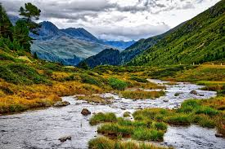

Slide 9
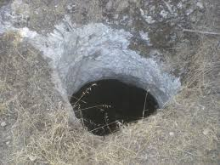

Slide 10
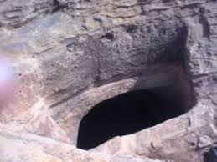

Slide 11
Why Would Jeremiah Hesitate?
The task was demanding
The times were difficult
Jeremiah was doubtful
The message was dangerous
Jeremiah 1:11-19.

Slide 12
Three Strands Of Truth
Past sin
Present responsibility
Future hope.

Slide 13
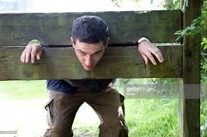

Slide 14
Three Promises From God
The almond tree – vs. 11-12
Extra Reading: Leviticus 26; Deuteronomy 28
II Kings 17:13-15
The boiling pot – vs. 13-16
Extra reading – Isaiah 30 – 31
Jeremiah 2:18, 36
The city pillar and wall – vs. 17-19
I am with you to deliver you.

Slide 15
Application
Do you think that you can’t serve the Lord?
Numbers 13:27
Do you trust that the Lord can send you?
Numbers 13:30.

Slide 16
How can you use one of these resources this week?

