Slide 1
Matthew 6: 25 Psalm 27
Viewing the New Year from a Christian perspective

Slide 2
New Year
New Year
A very confusing Holiday
60 million people will die this coming year
15,000 children will die very day
4,000 people die from highway accidents every year

Slide 3
New Year
Headlines of the media
China hoards half of world grain reserve, prepares for 'famine’
Airlines cancel 2,500 more flights worldwide as travel ordeal continues
San Franciscans speak out on crime in the city
Many U.S. shoppers racked up debt this holiday season
Teens now offered 'do not resuscitate' orders
College students face uncertainty as schools revert to remote classes

Slide 4
New Year
New state law orders insurers to fund body mutilations
Top health official: We misled parents to scare them into vaccinating kids
Terrified elites flood Beverly Hills' only gun store as chaos grows in California
Biden's staring into the abyss – and so are we
COVID lockdowns pushed nearly 100 million back into poverty

Slide 5
New Year
All these from just one news site
Jesus has the cure for anxiety
Matthew 6: 25-34
5 times He tells us to ”not worry”
Vs 25; 27; 28; 31; 34
Reason # 1… Not to worry
Matthew 6: 26
Look at the birds of the air
They do not sow or reap
Yet your Heavenly Father feeds them
How much time do think they spend worrying?

Slide 6
New Year
Matthew 6: 27 Reason # 2
Which of you by worrying can add…
How much can we shorten our lives through worry?
How many doctor visits over something seen on the Internet?
What is the real reason for masks?
What is the real reason for the so-called vaccine?

Slide 7
New Year
Matthew 6: 28-30
Clothing
What we will wear?
Consider the lilies of the field
They do not toil
They do not spin
Yet even Solomon in all his glory?

Slide 8
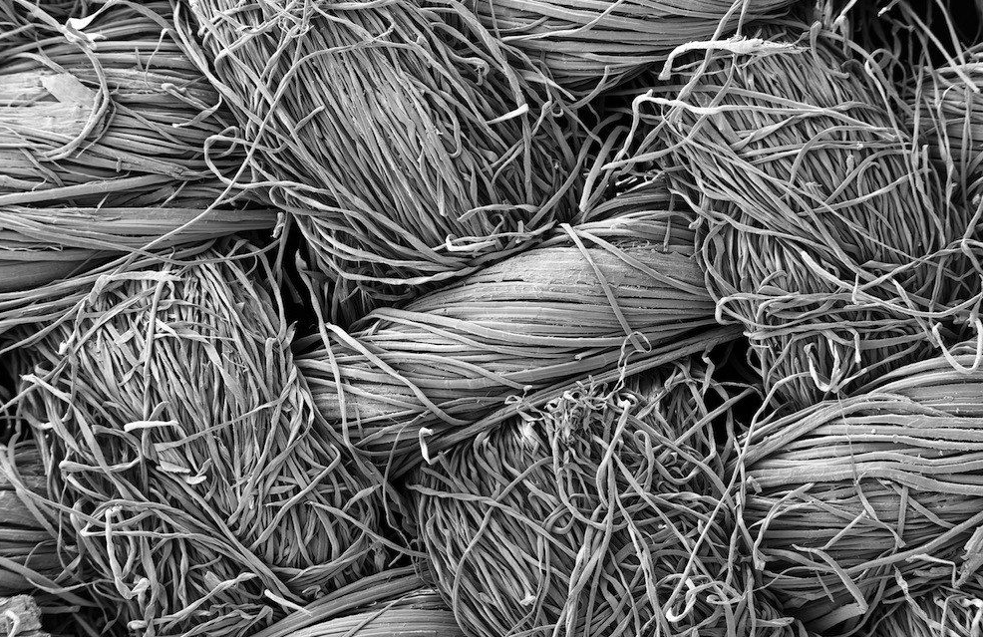
New Year
Vs 28-30
Clothing?

Slide 9
New Year

Slide 10
New Year
Matthew 6: 31
What will we eat?
For the Gentiles eagerly seek?
People outside the kingdom of God
This is what they live for
This is where they put all their energy
This is the entire focus of their life
Material things…
They have no external help…
Who can they cry out to?
They are their own saviors…

Slide 11
New Year
Matthew 6: 33-34… But seek first?
And do not worry about tomorrow
How do I do that?
Psalm 27
Psalm 27: 1-3
Foundation is laid for life
The Lord is!!!!!
My light and salvation
He is my Way Show-er
He is my only Redeemer

Slide 12
New Year
Psalm 27: 4
The Christian’s New Year resolution
One thing I have asked
That I may dwell in the house of the Lord
I have asked for “Guest Rights”
I want an unbroken consciousness
Of the presence of God
Where?
In my home, in my truck, in my car
On my tractor, in my garage, in Walmart, in Menards, in the hospital, at the funeral home

Slide 13
New Year
Consider
How this would affect
Our language?
What we watch?
What we listen to?
How we treat others?
Note the attitude of the Psalmist
This is the primary focus of his life
This “ONE THING”
That is all I want… this unbroken consciousness of God’s presence

Slide 14
New Year
Note the use of the words “have” and ”shall”
“Have” is in the past tense
“Shall” is in the present tense
Seek His presence
All the days of my life
Not just on Sunday, Wednesday night etc
Ephesians 2: 17-19
You are of God’s household
Philippians 3: 13… This one thing I do… Forget what is behind and press on and on and on

Slide 15
New Year
One sad thing about ”guest rights”
The guest is free to leave at any time
Psalmist is saying
I know that I can leave
But I want to stay…
Old Westminster Catechism
What is the whole duty of man?
To glorify God and to enjoy His presence forever

Slide 16
Christ in me
What gift of Grace is Jesus my Redeemer
There is no more for heaven now to give
He is my joy my righteousness and freedom
My steadfast love my deep and boundless peace

Slide 17
Christ in me
To this I hold my hope is only Jesus
For my life is wholly bound to His
Oh how strange and divine I can sing all is mine
Yet not I but through Christ in me.

Slide 18
Christ in me
The night is dark but I am not forsaken
For by my side the Saviour He will stay
I labour on in weakness and rejoicing
For in my need His power is displayed

Slide 19
Christ in me
To this I hold my Shepherd will defend me
Through the deepest valley He will lead
Oh the night has been won and I shall overcome
Yet not I but through Christ in me

Slide 20
Christ in me
No fate I dread I know I am forgiven
The future sure the price it has been paid
For Jesus bled and suffered for my pardon
And He was raised to overthrow the grave

Slide 21
Christ in me
To this I hold my sin has been defeated
Jesus now and ever is my plea
Oh the chains are released I can sing I am free
Yet not I but through Christ in me

Slide 22
Christ in me
With every breath I long to follow Jesus
For He has said that He will bring me home
And day by day I know He will renew me
Until I stand with joy before the throne

Slide 23
Christ in me
To this I hold my hope is only Jesus
All the glory evermore to Him
When the race is complete
Still my lips shall repeat
Yet not I but through Christ in me (2X)
To this I hold my hope is only Jesus

Slide 24
Psalm 42
As The Deer

Slide 25
Psalm 42
As the deer pants for the water
So my soul pants for You
All my tears have been my fodder
Day and night my only food

Slide 26
Psalm 42
Oh my soul you feel forgotten
Put your hope in Christ alone
As the deer longs for the water
So my soul longs to be whole

Slide 27
Psalm 42
Come Thou Fount of living water
Tune my heart to bless your name
Streams of trouble never ceasing
Call for songs of loudest praise

Slide 28
Psalm 42
As the deep cries out for answers
As your waves crash over me
Let your goodness like a fetter
Bind my broken heart to Thee

Slide 29
Psalm 42
In the night Your song is with me
Day by day You hold me fast
Oh my soul, hope in Jesus
You shall praise your God at last

Slide 30
Psalm 42
Come Thou Fount of living water
Tune my heart to bless your name
Streams of trouble never ceasing
Call for songs of loudest praise

Slide 31
Psalm 42
Deep calls to deep, waves of unbelief
Breakers crash and bring me falling to my knees
It goes on and on… where is my God
My salvation is in you and you alone

