Slide 1
John 1: 37-51
The Testimony of the First Disciples

Slide 2
John 1: 37-51
When we started our study of John
We find that John is fascinated with the fact that God became man and dwelt among us.
He is also determined in this Gospel to relate to us the testimony of who Jesus is
His reasoning is found in John 20: 30-31
The first testimony is from John the Baptist
The next testimony is found in our text today

Slide 3
John 1: 37-51
There are 4 declarative statements in this passage we are going to look at today
John 1: 41
”We have found the Messiah”
John 1: 45
We have found Him whom Moses in the Law and also the Prophets wrote”
John 1: 49
”Rabbi, you are the Son of God”
John 1: 51
“You are going to see amazing things”

Slide 4
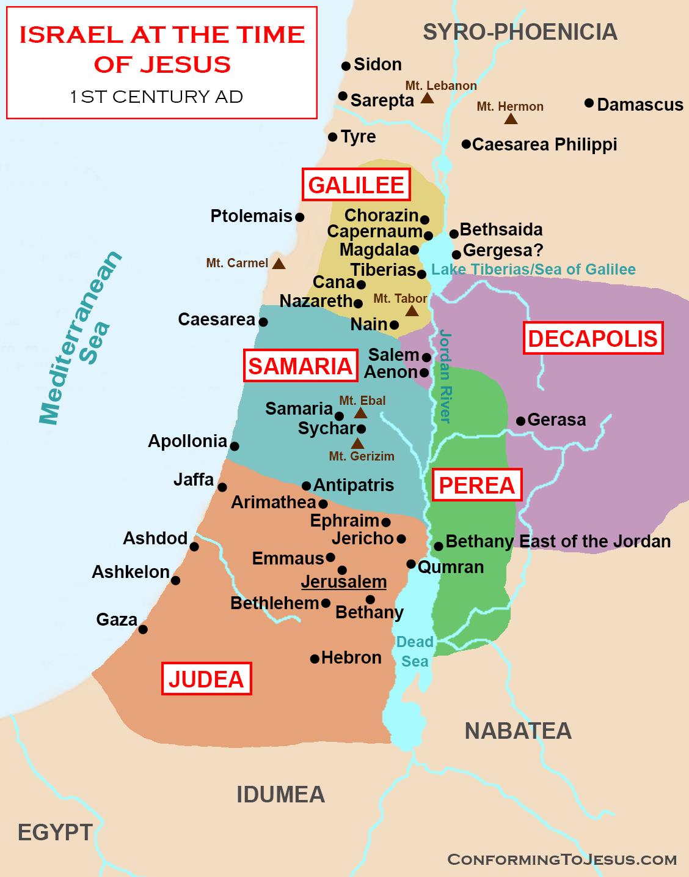

Slide 5
John 1: 37-51
Two disciples of JTB
John 1: 37-39
”What do you seek?”
They didn’t know
JTB has only been preaching for a short time (maybe only 6 mos. or so)
They knew nothing of Jesus
”Where are you staying?”
We would like to speak with you further
“Come and you will see”
Matthew 11: 28-30

Slide 6
John 1: 37-51
John 1: 38… they stayed with Him that day.
What did they discuss?
Luke 24: 13-27
“He explained to them the things concerning Himself in the Scriptures”
John 1: 40-41
Now can we understand why Andrew said what he did to Peter?
”we have found the Messiah” (Christ the Anointed One)
Note in Luke 24: 27…
“in all the Scriptures”
From Genesis to Revelation… the message is…
God’s plan of redemption through Christ

Slide 7
John 1: 37-51
John 1: 41… something we cannot overlook
“He first found his own brother”
Isn’t it interesting that the Gospel is shed abroad by word of mouth?
Peter goes to Jesus
Jesus gives Peter a new name
Cephas… meaning “stone”
Matthew 16: 13-18
Petros… meaning ”a stone”
Petra… meaning “large rock”
The Church is built upon the confession that is the Son of the living God. (I Peter 2: 5)
John 1: 43… the next day (day 4)
He found Philip

Slide 8
John 1: 37-51
Note all Jesus said to Philip is “follow Me”
Philip finds Nathaniel
John 1: 46… Nathaniel is skeptical
Philip gives the same invitation Andrew and John received “come and see”
Matthew 7: 7-11
John 1: 47-48
”I saw you under the fig tree”
4 things to learn from this statement

Slide 9
John 1: 37-51
Matthew 6: 5-6
First… Hebrews 4: 12-13
Jesus is fully God and nothing is hidden from Him… ”the Word became flesh…”
Second… just because you think something is of little value it does not mean it is
Matthew 10: 40-42; Mark 12: 41-44
Third… He sees us especially in our devotions
Acts 10: 1-4
Fourth… in our devotions our character is revealed
“Behold an Israelite in whom there is no deceit”

Slide 10
John 1: 37-51
John 1: 51… ”angels ascending and descending”
Genesis 28: 10-14
Do not miss Genesis 28: 13
“and behold the Lord stood above it”
Above it all stand the Lord of Lords
And King of Kings
Revelation 22: 6-9
“Worship God”

Slide 11
John 1: 37-51
One final thought
Of all the people Jesus called into His ministry
Not one was
Educated, refined, of popular renown
Not one was of the Sanhedrin or Priest
Not one was a Pharisee or Scribe
They were just like you and me
Ordinary people called to believe in and serve an extraordinary God

