Slide 1
Daniel 12: 3-4
Shining like stars

Slide 2
Daniel 12: 3-4
Quick review of last week (Vs 2)
We learned of three resurrections
Some say there are more…
I Corinthians 15: 23
Christ (Matthew 28: 6)
The First-Fruits (Matthew 27: 52-53)
N.T. Church saints (I Thessalonians 4: 15-18) “Rapture”
Tribulation saints (Revelation 20: 4)
O.T. saints (Revelation 20: 5)
Wicked dead (Revelation 20: 11-15)

Slide 3
Daniel 12: 3-4
Daniel 12: 3
KJV…”and they that be wise”
What is ”wisdom”?
Proverbs 3: 5-12
Note the progression
“Trust”
First step of gaining wisdom
Listing of “do nots”

Slide 4
Daniel 12: 3-4
Proverbs 3: 5-12
Do not……
Lean on your own understanding
Why not?
You and I do not know what tomorrow holds
But God does
Do not be wise in your own eyes
Psalm 14: 1
The fool has said
Schools and courtrooms are examples
Psalm 10: 3-4

Slide 5
Daniel 12: 3-4
Proverbs 3: 5-10
Do not
Be stingy
Do not reject the discipline of the Lord
Those whom He loves He reproves
Proverbs 9: 10-11
The fear of the Lord is the “beginning of wisdom”
Ecclesiastes 12: 9-14

Slide 6
Daniel 12: 3-4
Like the stars forever and ever
Who are these?
They are the ones who lead others to righteousness
They are those who will shine through all eternity
Proverbs 11: 30
He who wins souls is wise
Compare those to the ”stars” of this world

Slide 7
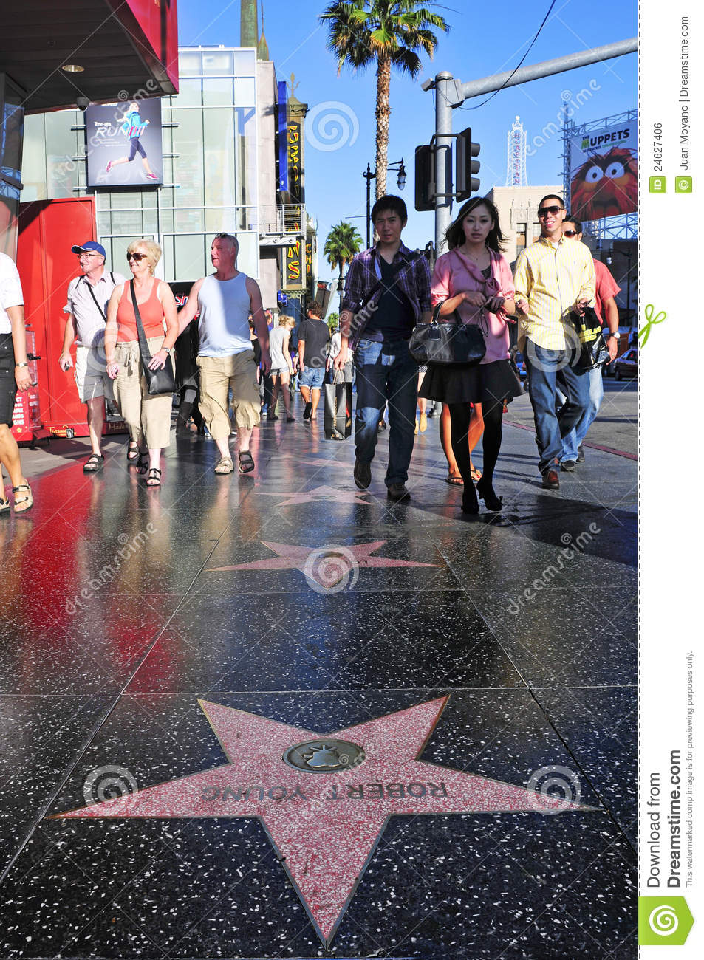

Slide 8
Daniel 12: 3-4
Vs 4
Conceal these words
Does not mean to “hide” as we would understand
But it means to “preserve”
To keep in a secure place
“Seal” the symbol of authority
What words?
Chapter 10-12
The vision of the “end of time”

Slide 9
Daniel 12: 3-4
What is the “end of time?”
It is the Great Tribulation period
At the “time of the end”
This book will be read and re-read
Over and over again… this book will be searched
Along with the book of the Revelation
Why?

Slide 10
Daniel 12: 3-4
4 reasons
During the Great Tribulation
The Word of God will not be speculation
It will be a fact of life
It will tell the whole world
God is in charge and not the Anti-Christ

Slide 11
Daniel 12: 3-4
3. God’s Word is always meant to be a comfort for His people
Even more so in times of distress
Daniel 12: 1….”there will be a time of distress”
4. So that all men everywhere are without excuse (Romans 1: 20)
Note the efforts of God to reach men
Sent the two witness (Revelation 11: 3-12)
Sent out the 144,000 Jewish evangelists (Revelation 7: 4-8)
Revelation 18: 1-8…..great angelic message
Book of Daniel and Revelation

Slide 12
Daniel 12: 3-4
Why is God willing to do all this?
II Peter 3: 9…
He is not willing that any should perish
But for all to come to repentance
Including me and you

