Slide 1
John 2: 13-17
My Father’s House

Slide 2
John 2: 13-17
Things to remember
John 20: 30-31
The main theme of the Book of John
John 2: 1-12
Jesus’ first miracle
Sort of a private event
Done in a small setting

Slide 3
John 2: 13-17
John 2: 13-17
Jesus is now entering in public ministry
Vs 13
At the Passover
Ex 12: 3-13
“When I see the blood I will pass over you”
Vs 15……
You shall eat unleavened bread for 7 days
Jerusalem had a population of about 200,000
During the Passover
Jews came from all over the world

Slide 4
John 2: 13-17
The city swelled to about 1 M people
It is estimated that 250,000 animals
Were to be sacrificed on this day
The Bible records Jesus attending 4 Passovers
Once when He was twelve
John 2, 7, 11
Twice He cleanses the temple
John 2: 13-17
Matt 21: 12-17
Note in Matt…..no scourge of cords
”My House”
Robber’s den

Slide 5
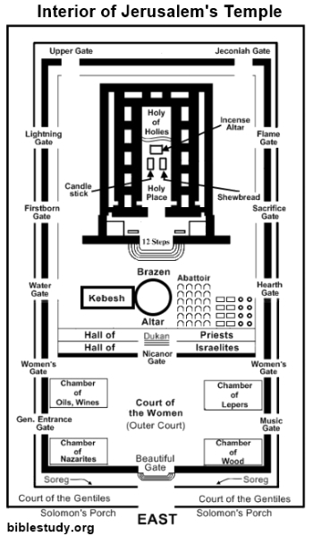
John 2: 13-17

Slide 6
John 2: 13-17
Interesting note
Jesus begins His public ministry at the Passover
He ends it on the Passover as well
When I see the blood I will pass over you
Vs 16
My Father’s house
John 5: 18…..
So it begins
Court of the Gentiles encompasses the whole temple
Maybe as many a 20-25 thousand people in there

Slide 7
John 2: 13-17
Vs 14
Selling oxen, sheep, doves, exchanging money
What drove this market?
Many travelled long distances
Did not take animals with them
At this time
Temple tax was also due
Could only be paid in Jewish currency
Exchanged at about 90 cents on the dollar
With 750,000 people coming for the Passover???

Slide 8
John 2: 13-17
Made a scourge of cords
What do you not see?
That He whipped or scourged anyone……
He simply drove them out
Why?
Isa 1: 10-17
They lost sight of worship and it all became ritual
What does this have to do with us?

Slide 9
John 2: 13-17
I Peter 4: 17
“it is time for judgment to begin with the household of God”
I Cor 11: 27-28
“Let a man examine himself”
What is our worship?
Does it showcase Isa 1?
Just ritual after ritual with no life application?
II Cor 5: 10
We are all going to appear at the judgment seat of Christ
I Cor 6: 12-20

Slide 10
John 2: 13-17
The Lord’s supper does not only allow us to commemorate His death
It allows us to examine our life
I can ask you all day long
What is the level of your commitment to Christ
But only you can answer that question
“Let a man examine himself”

Slide 12
Christ in Me
What gift of Grace is Jesus my Redeemer
There is no more for heaven now to give
He is my joy, my righteousness and freedom
My steadfast love my deep and boundless peace

Slide 13
Christ in Me
To this I hold my hope is only Jesus
For my life is wholly bound to His
Oh how strange and divine, I can sing all is mine
Yet not I but through Christ in me.

Slide 14
Christ in Me
The night is dark but I am not forsake
For by my side the Savior He will stay
I labor on in weakness and rejoicing
For in need His power is displayed

Slide 15
Christ in Me
To this I hold my shepherd will defend me
Through the deepest valley He will lead
Oh the night has been won and I shall overcome
Yet not I but though Christ in me

Slide 16
Christ in Me
No fate I dread I know I am forgiven
The future sure the price it has been paid
For Jesus bled and suffered for my pardon
And He was raised to overthrow the grave

Slide 17
Christ in Me
To this I hold my sin has been defeated
Jesus now and ever is my plea
Oh the chains are released I can sing I am free
Yet not I but through Christ in me

Slide 18
Christ in Me
With every breath I long to follow Jesus
For He has said that He will bring me home
And day by day I know He will renew me
Until I stand with joy before the Throne

Slide 19
Christ in Me
To this I hold my hope is only Jesus
All the glory ever more to to Him
When the race is complete still my lips shall repeat
Yet not I but through Christ in me (2X)
To this I hold my hope is only Jesus

