Slide 1
Psalm 139: 13-16
I Am Fearfully and Wonderfully Made

Slide 2
Psalm 139: 13-16
Three main texts for today
Psalm 139: 13-16
Genesis 1: 26-31
Romans 1: 18-20
1952… Whittaker Chambers
Avowed Communist
Converted to Christ
Due primarily to the birth of his daughter

Slide 3
Psalm 139: 13-16
Psalm 139: 13-16
There is perhaps nothing that shows the hardness of the unregenerate heart than abortion
Yet today
Roe Vs Wade is again under review
Advocates for abortion
Push for chemical inducing drugs to be available on-line
Even though the risk of death to the mother is 10 fold higher than surgical abortion

Slide 4
Psalm 139: 13-16
Question?
What is the reason behind this insane preoccupation with abortion?
Genesis 1: 26-31
This passage explains Psalm 139: 13-16
Note
Let Us
Triune God is creating mankind in “His Own Image”

Slide 5
Gen 1: 26-31
John 1: 1
“In the beginning was the Word”
When Moses wrote the first 5 books of the O.T.
He wrote them in Hebrew
The Hebrew alphabet has 22 letters
The human body made in the image of the Word
22 amino acids which make up all the proteins necessary to sustain life

Slide 6
Gen 1: 26-31
Bible teaches us that man is composed of 3 things
Body
Our physical state
Soul
That which makes us who we are
Spirit
That immortal part of every single person

Slide 7
Romans 1: 18-20
Romans 1: 19
“What is known about God is evident within them”
Human body is made up of three arenas
Brain
Central control system for the body
Heart…
Bible tells us this is the center of emotions
Intangible part
Reasoning, thinking, rationalization

Slide 8
Romans 1: 18-20
Focus today on the human body as created in the image of God
Various organs and bones
Each tell a story of how the Hand of God is showing us the Gospel
Heart
Lungs
Sternum
Ribs

Slide 9
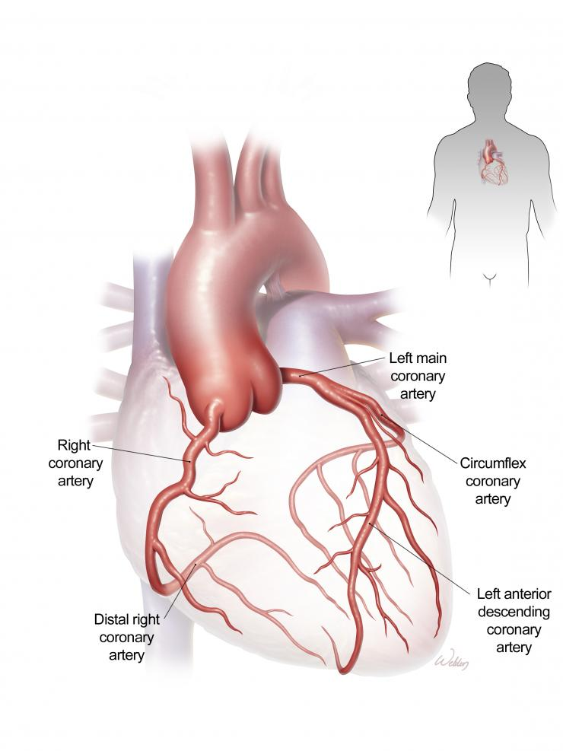
Romans 1: 18-20

Slide 10
Romans 1: 18-20
When medical science first began to study the heart
They named these arteries “coronary” arteries
Because the arteries resembled a “crown or a ‘coronation’ of thorns”
They supply nutrients to the heart muscle
There is only one cure for a thorny heart
Supplied with the nutrients of sin
Forgiveness from/through the One who wore a ”crown of thorns”

Slide 11
Romans 10: 10
The heart as a “throne room”
Who will sit on the throne of our hearts?
Romans 10: 10
Revelation 4: 5
Come flashings of lightning

Slide 12
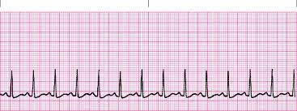
Revelation 4: 5

Slide 13
Revelation 4: 5
And sound and peals of thunder
The heart sounds like
Luh dub, luh dub, luh dub
Hebrew word for ”thunder”
La bib, la bib, la bib

Slide 14
Revelation 4: 6
Revelation 4: 6
4 living creatures
How are these illustrated in the human heart?
Every human heart has 4 valves
Tri-cuspid
Pulmonary
Mitral
Aorta
These four cry out
God… You are Worthy to receive
Glory, honor and power

Slide 15
Revelation 4: 5
Revelation 4: 5
Seven lamps of fire
Genesis 2: 7
God breathed into man the breath of life
Into what did He breathe?
Lungs
3 lobes on the right lung
2 lobes on the left lung
Both lungs connected by bronchial tubes
Connected to the trachea
Equaling 7 parts of the lungs

Slide 16
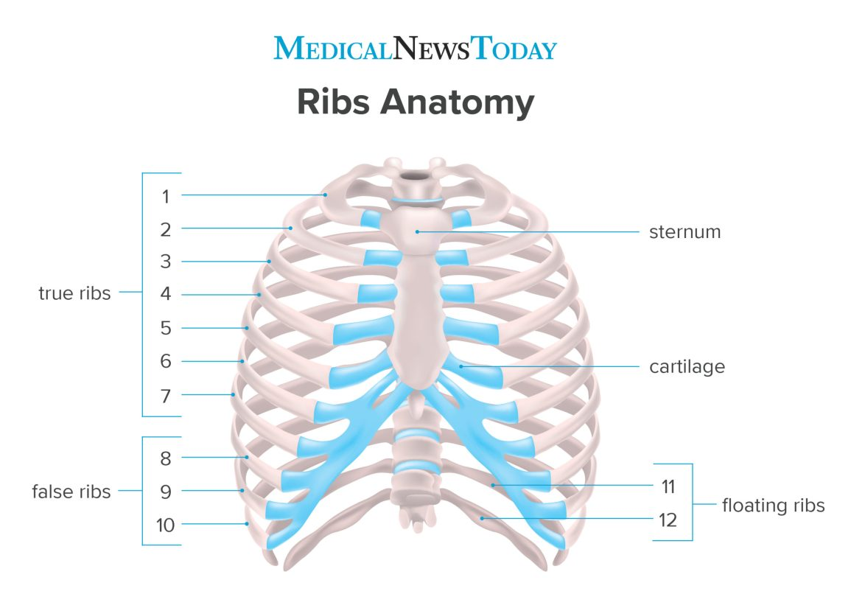
Revelation 4: 10

Slide 17
Revelation 4: 10
Revelation 4: 10… the 24 elders
There are 24 ribs in the human body
The fall and rise with every breath
The elders fall and rise in worship
Psalm 103:1

Slide 18
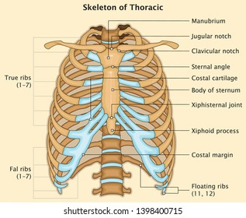
Hebrews 4: 12

Slide 19
Hebrews 4: 12
Picture of the Cross
Also a picture of a sword
Which divides the thoughts and intents of the heart
I Corinthians 6: 19-20
Do you not know your body
Is the temple of the Holy Spirit
Made in the image of God
That is why abortion is so loved by the unregenerate mind.

