Slide 1
Daniel 11
History of Israel

Slide 2
Daniel 11
Why should we study this or even know all the intricates of God’s dealing with Israel?
Three things we need to know
God has not and will never abandon Israel
Many times it is through suffering and severe trials, people come to Christ
Our faith is not some pie in the sky hope; we have a sure foundation in God’s Word evidence by the intricate details predicted far in advance of occurrence.

Slide 3
Daniel 11: 3-4
Alexander…
Prophecy @200 years before he was born
Rules until he is 33 years old
Conquered everything from Europe to India
His kingdom will be parceled out
Into 4 parts
But not with his descendants?
He had a half-brother, illegitimate son and his wife was pregnant at the time of his death
In the 17 years of the dividing of the kingdom all of these individuals are killed

Slide 4
Daniel 11: 4
Four divisions
Cassander takes Macedonia
Lysimachus takes Thrace and Asia Minor
Seleucus takes Syria
Ptolemy takes Egypt
“nor according to his authority”
Each will have a diminished power

Slide 5
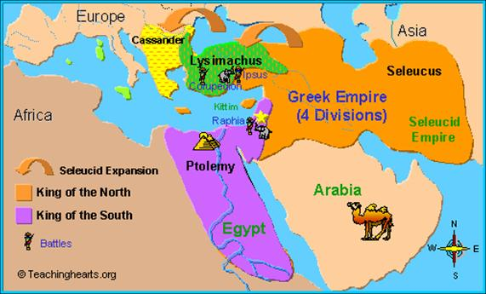
Grecian divisions

Slide 6
Daniel 11: 5-20
These verses focus on the conflict
Between Ptolemaic and Seleucid empires
Note the details
Vs 5-6
King of the south
Not just one king but several over the years listed in these verses
Ptolemaic kingdom or Egypt
Wants to make a pact with the king of the north… Seleucid kingdom… through marriage

Slide 7
Daniel 11: 6
One small problem
The king (Antiochus Theos) was already married
He divorces his wife
But (she) his ex-wife isn’t real happy about it
When the new wife (Berenice) shows up
The ex-wife murders the new wife
And all the attendants
And poisons her former husband
Fulfilling what is described in Vs 6

Slide 8
Daniel 11: 7-8
A new king ascends to the throne in the north… Callinicus
This whole affair doesn’t go over real well in the south
So a relative of the murdered queen assembles an army (Ptolemy Euergets)
Attacks the king of the north
Vs 8… takes their images etc..
History tells us
40,000 talents of silver and 2,500 idols

Slide 9
Daniel 11: 8
KJV “shall continue more years…”
Callinicus returning home falls off his horse and dies
Question… Where is all this fighting taking place? Daniel 9: 26… ”even to the end.”
History of Israel is one in the middle of almost continuous war/annihilation
Just as it is the case today
“Even to the end”… God’s Word will not be changed by any political entity
Even in our day!!!

Slide 10
Daniel 11: 10-12
Callinicus has two sons
Vs 10… His sons
“One of them” one of two dies
Other one, Antiochus the Great becomes king
He assembles an army and attacks the south
He has 75,000 soldiers, marches through Israel
King of the south (Philometer) assembles his army
73,000 soldiers, 5,000 calvary and 73 elephants
Vs 12… the king of the south prevails
King of the north loses
10,00 soldiers (Vs 12), 300 calvary and 5 elephants (Polybius)

Slide 11
Daniel 11: 13-19
Vs 13… ”after an interval of years”
13 years later… the king of the north attacks the south again
Vs 14… ”The violent ones of (your) people”
who are these people?
The subversives of the Jews
Fulfill a vison
To be free from all this war/occupation
King of the north promises this
Vs 16… he changes his mind

Slide 12
Daniel 11: 13-19
Vs 15 tells us how the battle was waged
The king of the north is victorious
Vs 16… stays for a time “in the Beautiful land”
“With destruction in his hand”
Vs 17… comes up with a peace plan between the north and south
Gives the “daughter of women”
Who is this?
Cleopatra
But she loves her husband more and will not stand (Vs 18)

Slide 13
Daniel 11: 18-19
King of the north turns his eyes toward the coastland (Greece)
Who is on the horizon?
It is the one who controls Greece at this time?
It is Rome
Vs 19 ”but he will stumble and fall”
Goes home and is so distressed over the loss
He raids the temple of the Syrian gods
People are so enraged… they kill him

Slide 14
What are we to learn?
First all of this was predicted at least 300 years prior and it was predicted accurately.
Isaiah 46: 8-11
God of the Bible declares the end from the beginning
That includes both heaven and hell
Showing the infallibility of God’s Word
In all things
Even for the United States
Secondly, Israel is in the center of God’s will and plan.
Finally, Psalm 46; Romans 8: 31-39
We can rest assured that nothing will ever separate us from the love of God…regardless of what may come our way

