Slide 1
The Sanctity of Life
Psalm 127:3
Genesis 1:26-31

Slide 2
The Sanctity of Life
If man is not created in the image of God?
Child abandonment (China)
Molech
Children with disabilities
Abortion on demand at any time
Because we are all just… animals

Slide 3
The Sanctity of Life
Since we all are just animals
Killing humans is no different
Killing rats, birds or animals
Where there is no God
There is no Law giver
There is no moral law (10 Commands)
Romans 2:14
So we get to make the rules

Slide 4
The Sanctity of Life
C. Everett Koop
“Current sexual mores, and the breakdown of the family demand abortion. At the same time, the availability of abortion contributes to a change in our sexual mores, and general family breakdown - truly a vicious cycle.”

Slide 5
The Sanctity of Life
Exodus 21:22-25… no difference in the 3
Psalm 139:13-16… note “you formed me”
Jeremiah 1:5…..before I formed ”you”
When is the person ”created in the image of God?” At what stage of development?
Scripture is silent on this point

Slide 6
The Sanctity of Life
If God knows a person before they are born
Does it not stand to reason
The unborn person is human?
If the person is human
Do they not have rights?
When do they get those rights?
Who determines that?

Slide 7
The Sanctity of Life
Arguments
When they are viable…
Able to live outside the womb on their own
New technologies lowering the age of viability

Slide 8
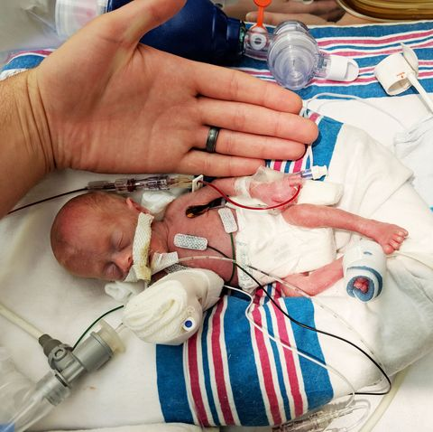
The Sanctity of Life

Slide 9
The Sanctity of Life
At 21 days… heartbeat is detected
45 days… brain waves detected
11 weeks… child can
Squint, swallow, move its tongue
Has fingerprints, taste
It has to be able to live without its mother
What about all the 25-year-olds in the basement?

Slide 10
The Sanctity of Life
It has to have potential
What about people in the nursing homes?
What about disabled people?
Have you ever asked if they wished their parents would have aborted them?
Steven Hawking
Helen Keller
Ray Charles

Slide 11
The Sanctity of Life
Abortion for unwanted children
Has child abuse gone up or down since?
If your child is a drain on you????
What about incest or rape?
Will one violent act be offset by another?
Will one trauma offset the other?

Slide 12
The Sanctity of Life
What are we to do?
John 4:35
There are thousands of women who are hurting
The love of Christ will set them free

